Slide 1
Tracking healthcare costs
By Lorena Sandoval

Slide 2
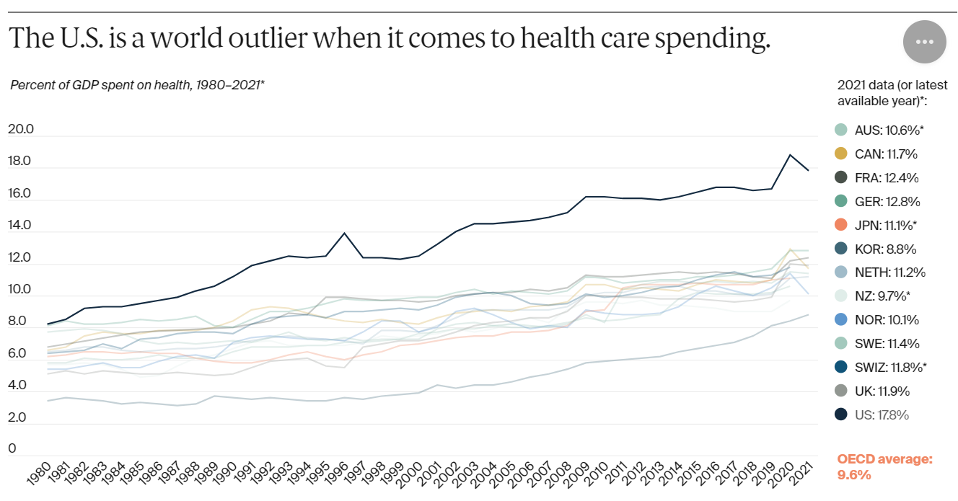
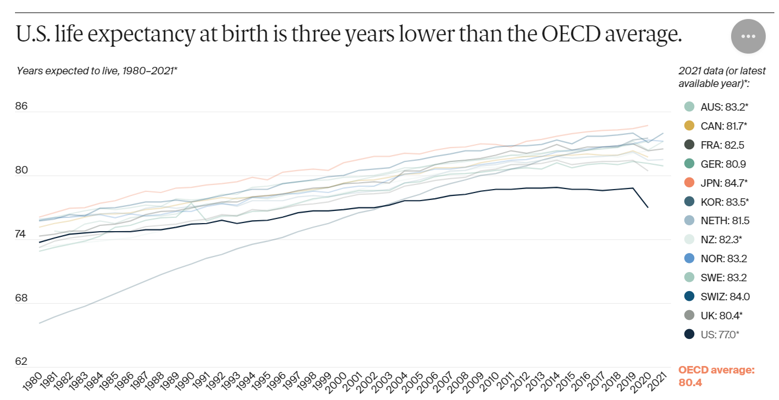
Healthcare Spending has outpaced economic growth
Source: Munira Z. Gunja, Evan D. Gumas, and Reginald D. Williams II, U.S. Health Care from a Global Perspective, 2022: Accelerating Spending,
Worsening Outcomes (Commonwealth Fund, Jan. 2023).
OECD = Organisation for Economic Co-operation and Development

Slide 3
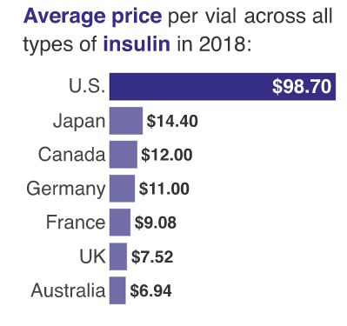
Insulin costs
Average gross manufacturer price for a standard unit of insulin in 2018 was $98.70 in the U.S., compared with $8.81 in 32 OECD countries
Source: https://www.rand.org/blog/rand-review/2021/01/the-astronomical-price-of-insulin-hurts-american-families.html
OECD = Organisation for Economic Co-operation and Development
Notes:
Drug report to congress 2020
https://aspe.hhs.gov/sites/default/files/private/aspe-files/263451/2020-drug-pricing-report-congress-final.pdf

Slide 4
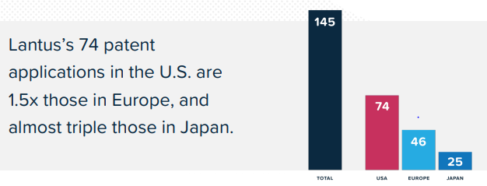
Patent abuse is driving up drug prices - Lantus
U.S. law provides 20 years of patent exclusivity
70 secondary patent applications in the U.S.
Gives Sanofi monopoly protection for up to 37 more years
Notes:
http://www.i-mak.org/wp-content/uploads/2018/10/I-MAK-Lantus-Report-2018-10-30F.pdf

Slide 5
Previous and Recent policy patchwork
Obamacare
To ensure that pharmaceutical companies would be on board, HHS was not given the ability to negotiate drug prices on behalf of public players
No Surprises Act (NSA)
Protects consumers from out-of-network billing for emergency and out-of-network supplemental care (i.e. anesthesiology)
Inflation Reduction Act
government was prohibited from directly negotiating drug prices in Medicare Part D, the prescription drug coverage program
caps out-of-pocket monthly cost for covered insulin products
Notes:
https://www.consumerfinance.gov/ask-cfpb/what-is-a-surprise-medical-bill-and-what-should-i-know-about-the-no-surprises-act-en-2123/
How does the No Surprises Act protect me?
Effective January 1, 2022, the No Surprises Act (NSA) protects you from surprise billing if you have a group health plan or group or individual health insurance coverage, and bans:
Surprise bills for emergency services from an out-of-network provider or facility and without prior authorization
Out-of-network cost-sharing, like out-of-network coinsurance or copayments, for all emergency and some non-emergency services
Out-of-network charges and balance bills for supplemental care, like radiology or anesthesiology, by out-of-network providers that work at an in-network facility
The No Surprises Ac

Slide 6
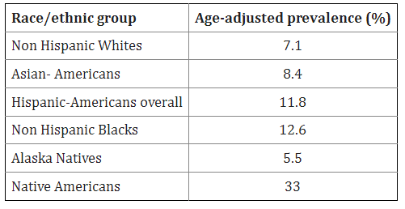
Why does this matter?
Age-adjusted prevalence of diagnosed diabetes mellitus in the US by race/ethnicity in adults ≥20 years of age
Higher rates of uninsured/underinsured among minorities causes insulin rationing and increased mortality rates
http://www.cdc.gov/diabetes/pubs/pdf/ndfs_2011.pdf
Notes:
Diabetes by race/ethnicity 2018-2019
CDC https://www.cdc.gov/diabetes/data/statistics-report/diagnosed-diabetes.html
14.5% of American Indians/Alaskan Natives
12.1% of non-Hispanic blacks
11.8% of Hispanics
9.5% of Asian Americans
7.4% of non-Hispanic whites

